Slide 1
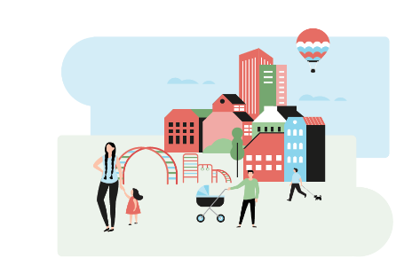
Elverum municipality has chosen to settle refugees
In Norway is settlement of refugees a voluntary municipal task and the municipalities that receive a request from the directorate (IMDI) decide for themselves whether to settle refugees.
Elverum municipality now has 110 resident refugees within the 5-year period

Slide 2
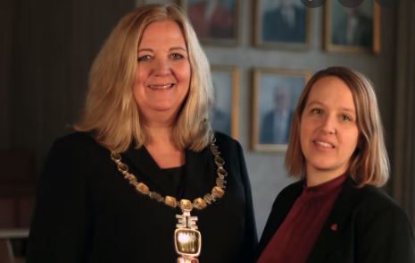
This is implemented in the municipality's planning and values
“Elverum municipality must settle refugees”
“The integration work shall be for mutual enrichment for all the inhabitants of the municipality”
Mayor Lillian Skjærvik and Deputy Mayer Eldri Svisdal

Slide 3
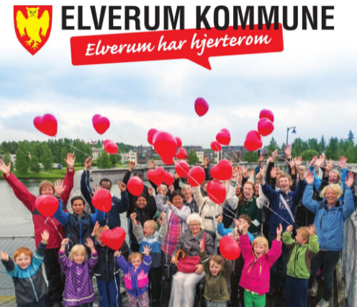
“Elverum har hjerterom”:
This means that the municipality wants to be an inclusive city with care and consideration for everyone

Slide 4
Planned settlements in 2022
Request from the directorate (IMDI):
18 included 4 children without parents
Quantity: uncertain
(2)
By agreement between municipalities
(1)
The Directorate of Integration and Diversity (IMDi)
The Norwegian Directorate of Immigration
Children without parents
UN refugee
From asylum reception
Family reunion
Secondary residents
Settled directly in collaboration with the UN High Commissioner for Refugees
Resident after stay at reception pending a granted residence permit
Is under 18 years of age at the time of settlement
Family reunion
From another minicipalities i Norway
Political decisions in
Elverum municipalities: 18
(1) IMDi implements the governments integration policies and support the municipalties in the integration process .
(2) The UDI is responsible for applications from foreigners who want to visit or live in Norway

Slide 5
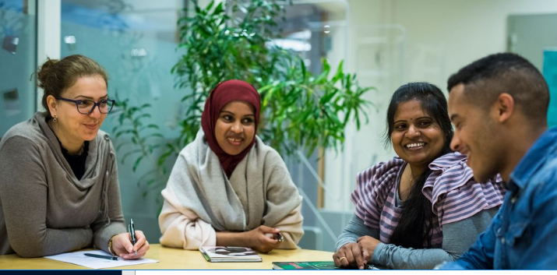
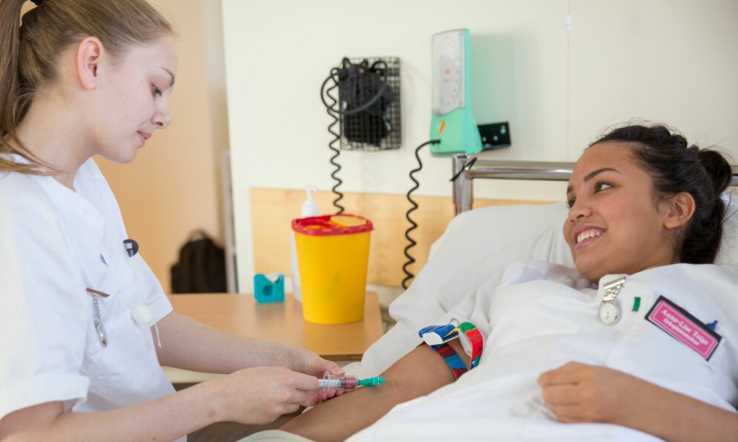
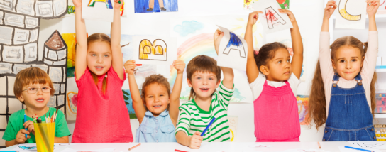
All municipalities that settle refugees are obliged to offer refugees between the ages of 18 and 55 the introduction program
The program focuses on the fastest way to school or work
School and practice
Children is integrated in school, kindergarten and leisure activities

Slide 6
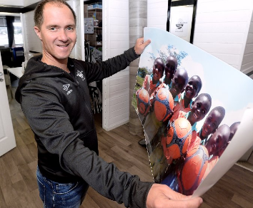
We are working together with several voluntary organizations
One of our partners is Elverum football club
About 40 nationalities in the club
About 180 players with connections to another country
Integration is part of the strategy and daily routine
Anders Bronken, Elverum football club
“The uniqueness of football means
that it will be a natural integration arena”

Slide 7
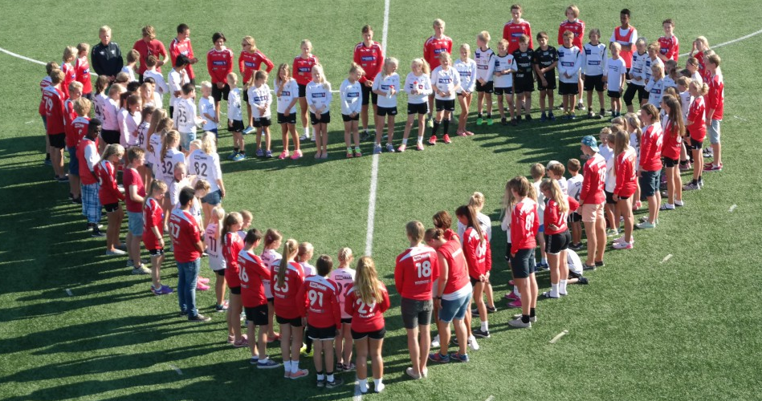
Thank you
We are looking forward to seeing you again.
☺

